Slide 1
Asymptotic Analysis
BEFORE WE START
Which of the following is an invariant of our LinkedList implementation? a) it can store any type inside
b) adding at the front is O(1)
c) the last node’s next field is null

Slide 2
Announcements
Project 0 (CSE 143 Review) due Wednesday 7/1 11:59pm
Project 1 (Deques) comes out the same day
Partner sign-up form due Tuesday 6/30 11:59pm
Three options for projects:
Choose a partner – someone you know or meet in the class
Join the partner pool – we’ll assign you a partner (default)
Opt to work alone – not recommended, but available
Friday (July 3rd) is a holiday: Independence Day (observed)
No lecture
Exercise 1 (written, individual) released Friday

Slide 3
Learning Objectives
After this lecture, you should be able to...
Describe the difference between Code Modeling and Asymptotic Analysis (both components of Algorithmic Analysis)
Model a (simple) piece of code with a function describing its runtime
Explain why we can throw away constants when we compute Big-Oh bounds
Identify whether Big-Oh (and Big-Omega, Big-Theta) statements about a function are accurate

Slide 4
Lecture Outline
Overview: Algorithmic Analysis
Code Modeling
Asymptotic Analysis
Big-O, Big-Omega, Big-Theta

Slide 5
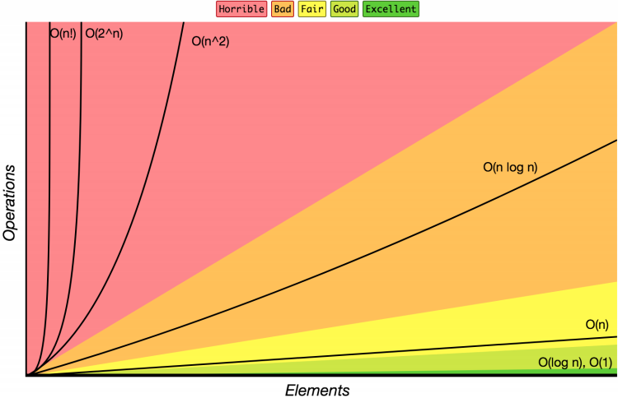
143 Review Complexity Class
Complexity Class: a category of algorithm efficiency based on the algorithm’s relationship to the input size N
Complexity Class | Big-O | Runtime if you double N
constant | O(1) | unchanged
logarithmic | O(log₂ N) | increases slightly
linear | O(N) | doubles
log-linear | O(N log₂ N) | slightly more than doubles
quadratic | O(N²) | quadruples
... | ... | ...
exponential | O(2^{N}) | multiplies drastically

Slide 6
Review Big-Oh Analysis: Why?
 | ArrayList | LinkedList
add (front) | O(n) linear | O(1) constant
remove (front) | O(n) linear | O(1) constant
add (back) | O(1) constant usually | O(n) linear
remove (back) | O(1) constant | O(n) linear
get | O(1) constant | O(n) linear
insert (anywhere) | O(n) linear | O(n) linear
Complexity classes help us differentiate between data structures
“Just change first node” vs. “Change every element” is clearly different
To evaluate data structures, need to understand impact of design decisions

Slide 7
Review Big-Oh Analysis: Why?
We need a tool to analyze code, and we want it to be:
A
Simple
We don’t care about tiny differences in implementation, want the big picture result
B
Mathematically Rigorous
Use mathematical functions as a precise, flexible basis
Decisive
Produce a clear comparison indicating which code takes “longer”
C

Slide 8
Review Big-Oh Analysis: ... How?!
CODE
BIG-OH
?
for (i = 0; i < n; i++) {
a[i] = 1;
b[i] = 2;
}
O(n)
143 general patterns: “O(1) constant is no loops, O(n) is one loop, O(n²) is nested loops”
This is still useful!
But in 373 we’ll go much more in depth: we can explain more about why, and how to handle more complex cases when they arise (which they will!)

Slide 9
Overview: Algorithmic Analysis
1
2
CODE
RUNTIME
FUNCTION
COMPLEXITY
CLASS
Code Modeling
Asymptotic Analysis
for (i = 0; i < n; i++) {
a[i] = 1;
b[i] = 2;
}
f(n) = 2n
O(n)
Algorithmic Analysis: The overall process of characterizing code with a complexity class, consisting of:
Code Modeling: Code → Function describing code’s runtime
Asymptotic Analysis: Function → Complexity class describing asymptotic behavior
Notes:
Today, brief (1) then mostly (2)
Wednesday, more detail on (1)

Slide 10
Talking About Code
Cost Model: An analysis mindset to express the resource whose growth rate is being measured
For simplicity, we’ll discuss everything in terms of runtime today
But other cost models exist! For example, storage space is common
This topic has a lot of details/relationships between concepts
We’ll try to introduce things one at a time, but might take until next week for a “full”/satisfying picture to emerge

Slide 11
Lecture Outline
Overview: Algorithmic Analysis
Code Modeling
Asymptotic Analysis
Big-O, Big-Omega, Big-Theta

Slide 12
Code Modeling
1
CODE
RUNTIME
FUNCTION
Code Modeling
Code Modeling – the process of mathematically representing how many operations a piece of code will run in relation to the input size n.
Convert from code to a function representing its runtime

Slide 13
What is an operation?
We don’t know exact runtime of every operation, but for now let’s try simplifying assumption: all basic operations take the same time
Basics:
+, -, /, *, %, ==
Assignment
Returning
Variable/array access
Function Calls
Total runtime in body
Remember: new calls a function (constructor)
Conditionals
Test + time for the followed branch
Learn how to reason about branch later
Loops
Number of iterations * total runtime in condition and body

Slide 14
Code Modeling Example I
public void method1(int n) {
int sum = 0;
int i = 0;
while (i < n) {
sum = sum + (i * 3);
i = i + 1;
}
return sum;
}
+1
+1
+1
Loop runs n times
+3
+6
*n
+2
+1
f(n) = 6n + 3

Slide 15
Code Modeling Example II
public void method2(int n) {
int sum = 0;
int i = 0;
while (i < n) {
int j = 0;
while (j < n) {
if (j % 2 == 0) {
// do nothing
}
sum = sum + (i * 3) + j;
j = j + 1;
}
i = i + 1;
} return sum;
}
+1
+1
+1
+1
+1
This outer loop
runs n times
This inner loop
runs n times
+2
9n + 3
*n
+9
*n
+4
+2
+2
f(n) = (9n+3)n + 3
+1

Slide 16
Lecture Outline
Overview: Algorithmic Analysis
Code Modeling
Asymptotic Analysis
Big-O, Big-Omega, Big-Theta

Slide 17
Where are we?
1
2
CODE
RUNTIME
FUNCTION
COMPLEXITY
CLASS
Code Modeling
Asymptotic Analysis
for (i = 0; i < n; i++) {
a[i] = 1;
b[i] = 2;
}
f(n) = 2n
O(n)
We just turned a piece of code into a function!
We’ll look at better alternatives for code modeling later
Now to focus on step 2, asymptotic analysis

Slide 18
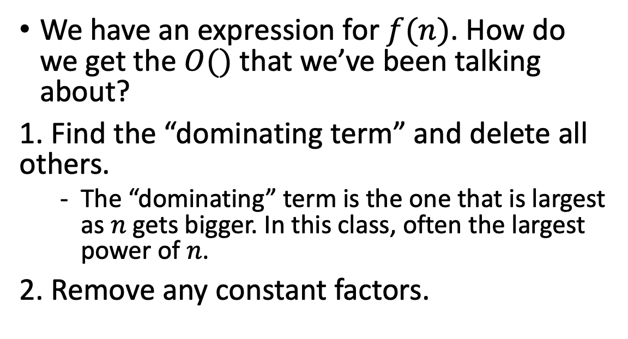
Finding a Big-Oh
2
RUNTIME
FUNCTION
COMPLEXITY
CLASS
Asymptotic Analysis
We have an expression for $f(n)$. How do we get the $O()$ that we’ve been talking about?
1. Find the “dominating term” and delete all others.
The “dominating” term is the one that is largest as $n$ gets bigger. In this class, often the largest power of $n$.
2. Remove any constant factors.
f(n) = (9n+3)n + 3
= 9n² + 3n + 3
≈ 9n²
≈ n²
f(n) is O(n²)
Notes:
Asymptotic Analysis works for any function

Slide 19
Is it okay to throw away all that info?
Big-Oh is like the “significant digits” of computer science
Asymptotic Analysis: Analysis of function behavior as its input approaches infinity
We only care about what happens when n approaches infinity
For small inputs, doesn’t really matter: all code is “fast enough”
Since we’re dealing with infinity, constants and lower-order terms don’t meaningfully add to the final result. The highest-order term is what drives growth!
Remember our goals:
A
Simple
We don’t care about tiny differences in implementation, want the big picture result
Decisive
Produce a clear comparison indicating which code takes “longer”
C

Slide 20
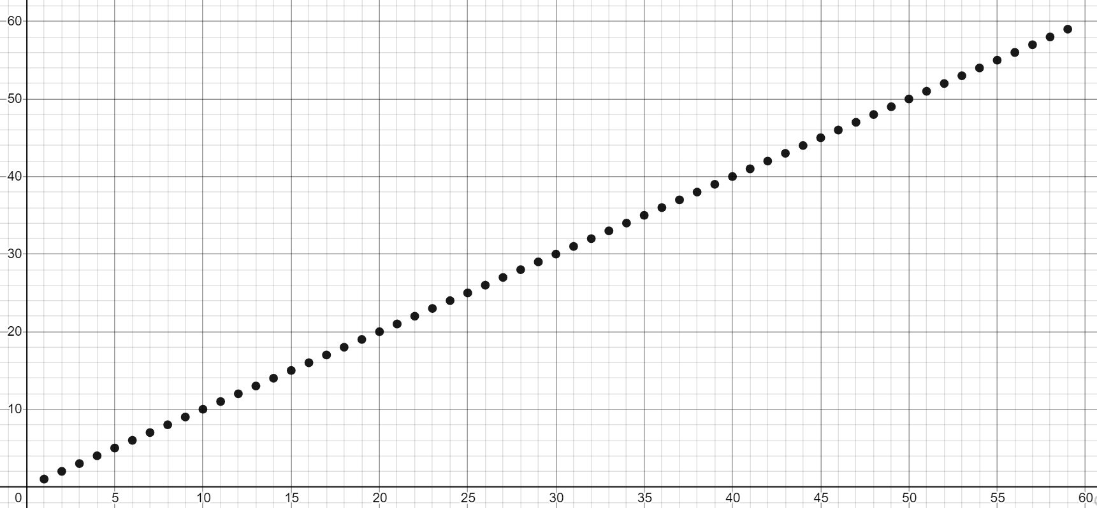
No seriously, this is really okay?
There are tiny variations in these functions (2n vs. 3n vs. 3n+1)
But at infinity, will be clearly grouped together
We care about which group a function belongs in
Let’s convince ourselves this is the right thing to do:
https://www.desmos.com/calculator/t9qvn56yyb

Slide 21
What is an operation, again?
We could try being more precise, and count up individual operations
Then, sum the time each operation takes
But how long do they take? Some architectures are really fast at +, others faster at assignment
And when we compile it, our code gets expressed as lower-level operations anyway! It’s almost impossible to stare at code and know the “true” constants.
public void method1(int n) {
int sum = 0;
int i = 0;
while (i < n) {
sum = sum + (i * 3);
i = i + 1;
}
return sum;
}
Operation | Count
Assignment | 2 + 2n
< | n
+ | 2n
* | n
Return | 1
public static void method1(int[]); Code:
0: aload_0 1: arraylength 2: istore_1 3: aload_0 4: iload_1 5: iconst_1 6: isub 7: aload_0 8: iconst_3 9: iaload
10: aload_0 11: iconst_4 12: iaload 13: iadd 14: iastore 15: aload_0 16: iconst_0 17: dup2 18: iaload 19: aload_0
20: iconst_1 21: iaload 22: iadd 23: iastore 24: return

Slide 22
Code Modeling Anticipating Asymptotic Analysis
We can’t accurately model the constant factors just by staring at the code.
And the lower-order terms matter even less than the constant factors.
Since they’re going to be thrown away anyway, you can anticipate which constants are unnecessary to count precisely during Code Modeling
e.g. a loop body containing a constant 2 vs. 10 operations is unimportant here
This does not mean you shouldn’t care about constant factors ever – they are important in real code!
Asymptotic analysis is just one tool, but other perspectives that do consider constants are also valid and useful!

Slide 23
Lecture Outline
Overview: Algorithmic Analysis
Code Modeling
Asymptotic Analysis
Big-O, Big-Omega, Big-Theta

Slide 24
Using Formal Definitions
If analyzing simple or familiar functions, don’t bother with the formal definition. You can be comfortable using your intuition!
We’re going to be making more subtle big-O statements in this class.
We need a mathematical definition to be sure we know exactly where we are.
We’re going to teach you how to use the formal definition, so if you come across a weird edge case, you know how to get your bearings.
B
Mathematically Rigorous
Use mathematical functions as a precise, flexible basis

Slide 25
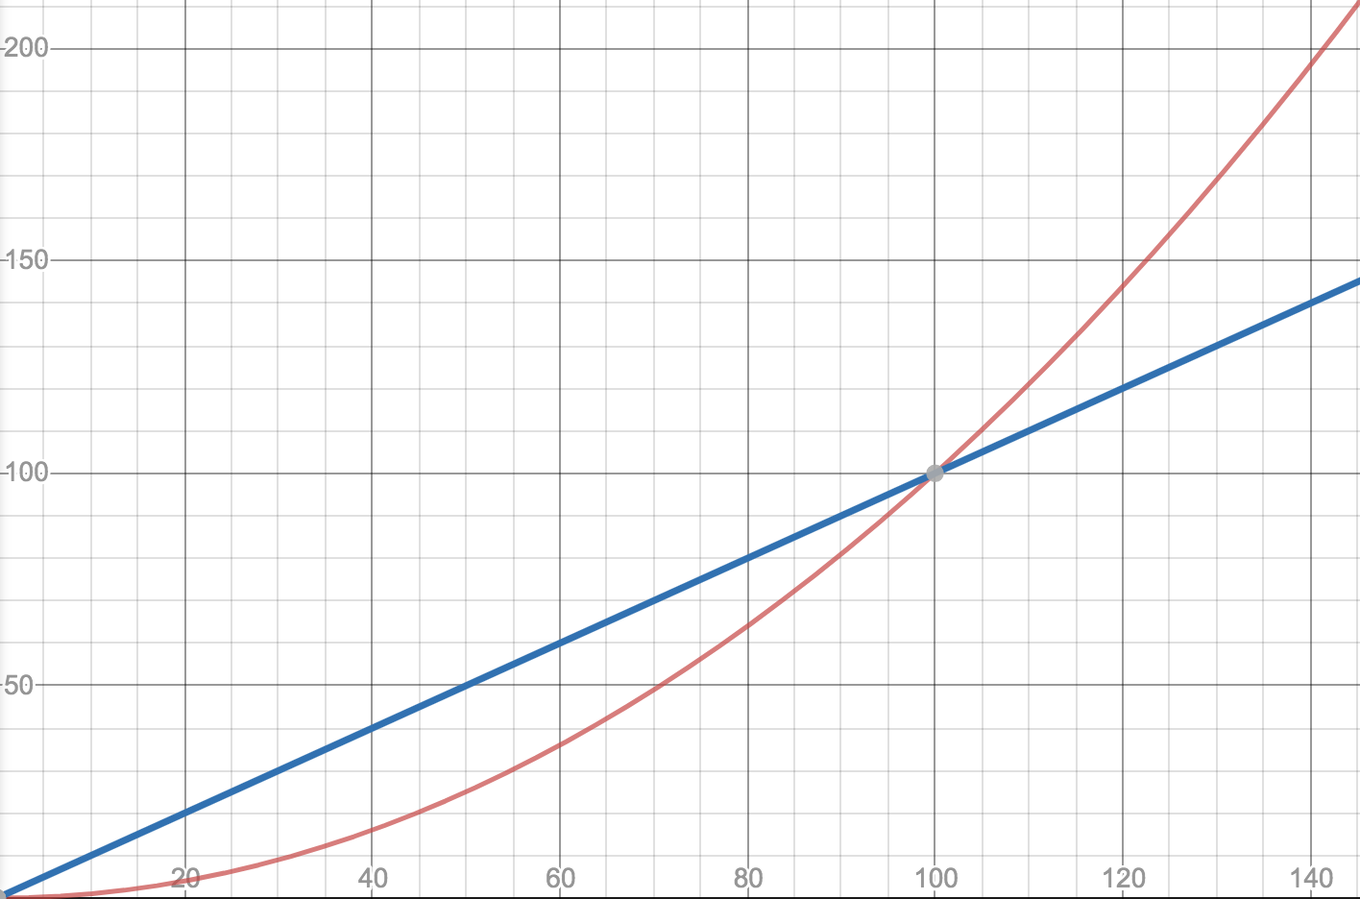
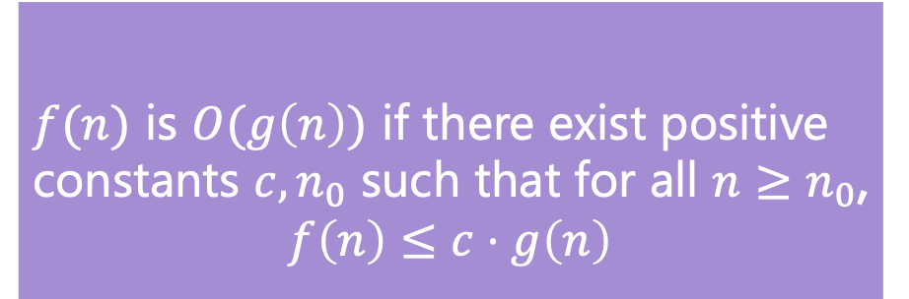
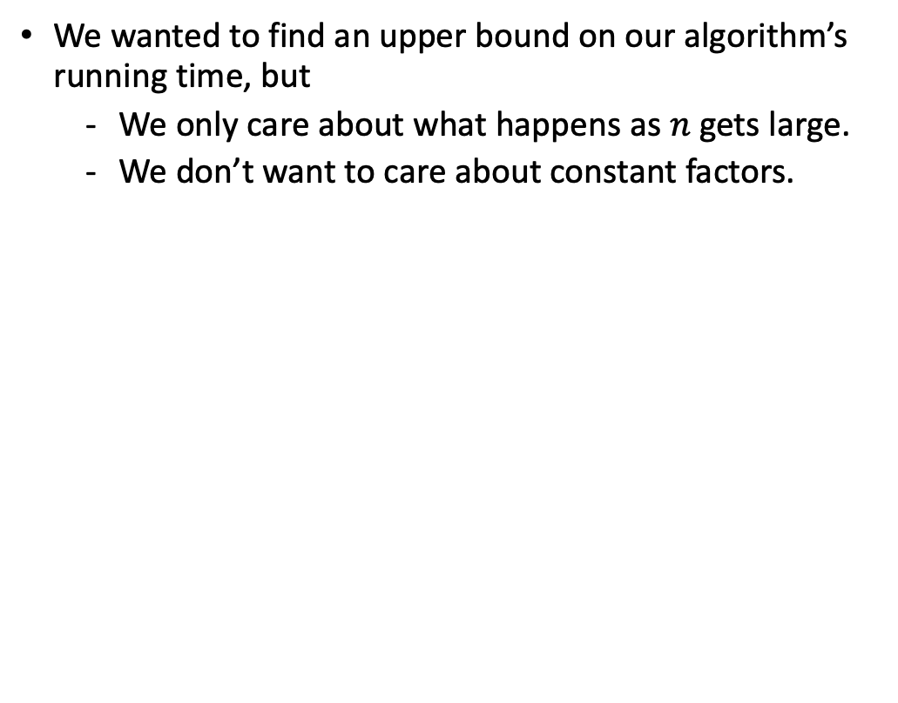
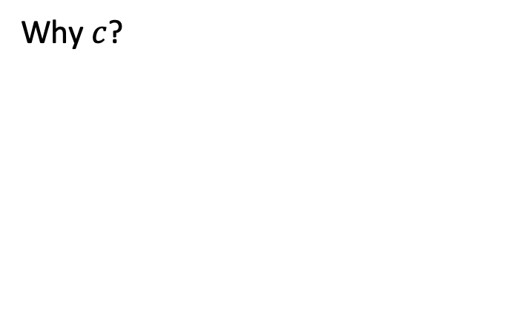

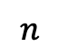

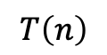
Big-Oh Definition
Why $n_{0}$?
f1(n)=0.01n²
We wanted to find an upper bound on our algorithm’s running time, but
We only care about what happens as $n$ gets large.
We don’t want to care about constant factors.
f2(n)=n
$f(n)$ is $O(g\left(n\right))$ if there exist positive constants $c, n_{0}$ such that for all $n≥n_{0}$,
$$f\left(n\right)≤c⋅g\left(n\right)$$
Big-Oh
Why $c$?
$$T\left(n\right)$$
We also say that $g\left(n\right)$ “dominates” $f(n)$
f1(n)=5n
$$n$$
f2(n)=n

Slide 26
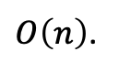
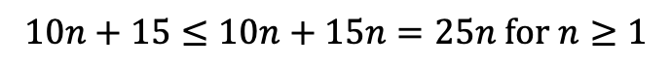
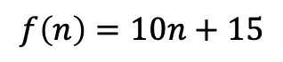
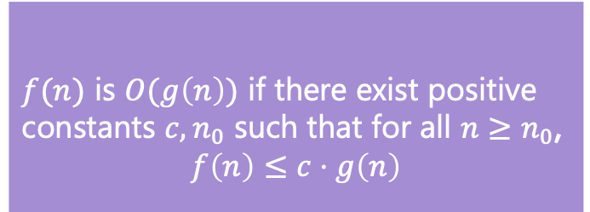
Big-Oh Proofs
$f(n)$ is $O(g\left(n\right))$ if there exist positive constants $c, n_{0}$ such that for all $n≥n_{0}$,
$$f\left(n\right)≤c⋅g\left(n\right)$$
Big-Oh
Show that
$$f\left(n\right)=10n+15$$
is
$O\left(n\right)$.
Apply definition term by term
$$10n≤c・n when c=10 for all values of n. So 10n≤10n$$
$15≤c・n when c=15 for n≥1.$ $So 15≤15n$
Add up all your truths
$$10n+15≤10n+15n=25n for n≥1$$
10n + 15 <= 25n for n >= 1.
which is in the form of the definition
f(n) <= c * g(n)
where c = 25 and n₀ = 1.

Slide 27
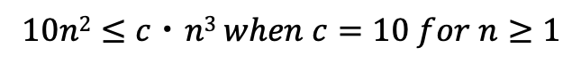
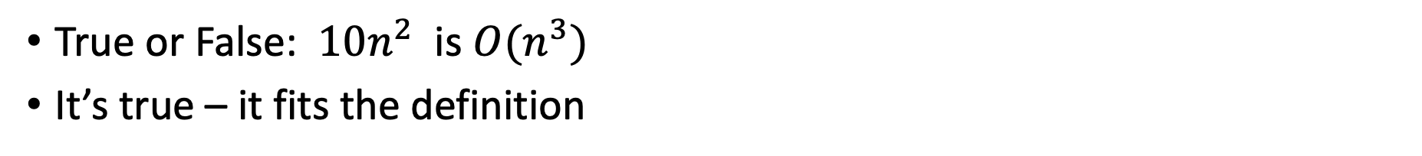
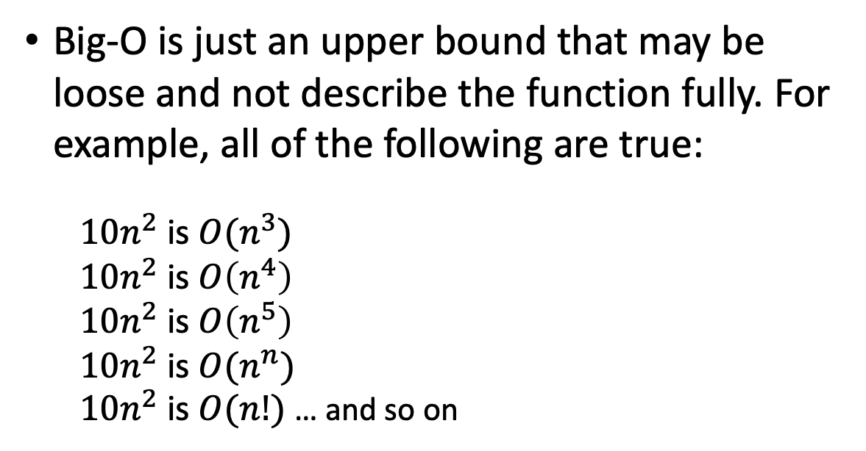
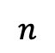
Big-Oh Doesn’t Have to be Tight
True or False: $10n^{2}$ is $O(n^{3})$
It’s true – it fits the definition
n⁵
$$10n2≤c・n3 when c=10 for n≥1$$
n⁴
$$T\left(n\right)$$
Big-O is just an upper bound that may be loose and not describe the function fully. For example, all of the following are true:
$10n^{2}$is $O(n^{3})$
$10n^{2}$is $O\left(n^{4}\right)$
$10n^{2}$is $O\left(n^{5}\right)$
$10n^{2}$is $O(n^{n})$
$10n^{2}$is $O(n!)$ … and so on
n³
10n²
$$n$$

Slide 28
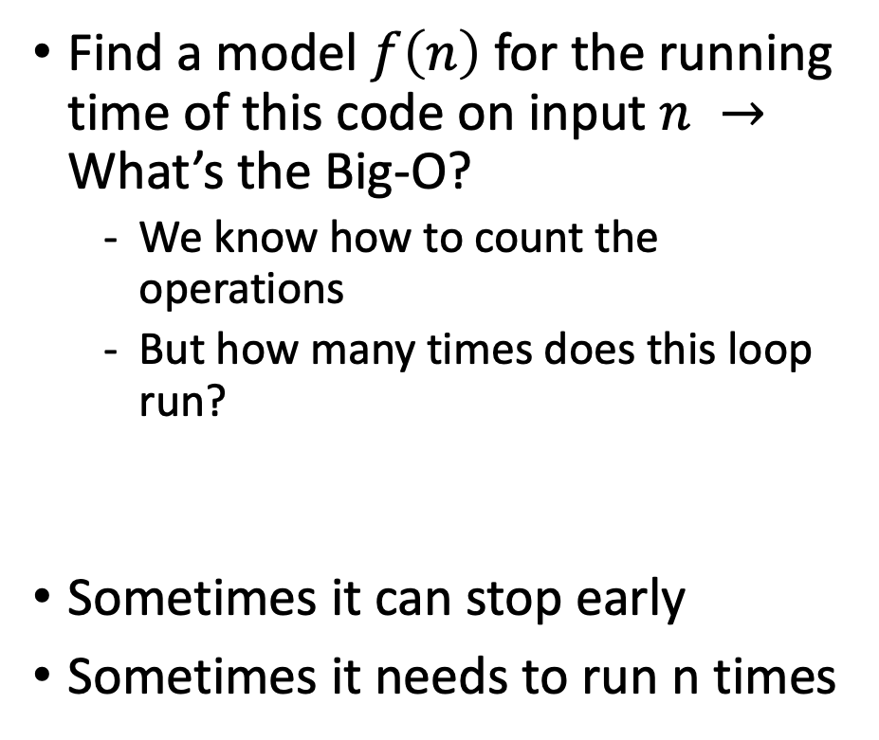
Uncharted Waters: Prime Checking
Find a model $f\left(n\right)$ for the running time of this code on input $n →$ What’s the Big-O?
We know how to count the operations
But how many times does this loop run?
Sometimes it can stop early
Sometimes it needs to run n times
boolean isPrime(int n) {
int toTest = 2;
while(toTest < n) {
if (n % toTest == 0) {
return true;
} else {
toTest += 1;
}
}
return false;
}
+1
+1
+2
+1
~+5
*?
+2
+1

Slide 29
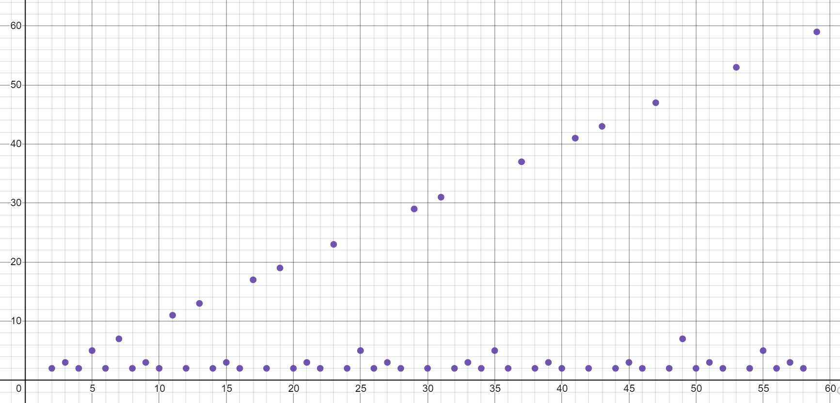
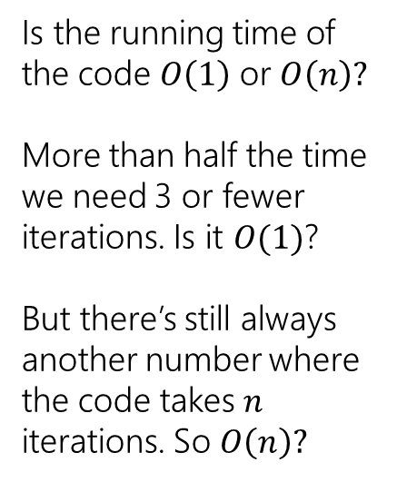
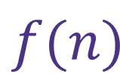
Prime Checking Runtime
$$f(n)$$
Is the running time of the code $O\left(1\right)$ or $O\left(n\right)?$
More than half the time we need 3 or fewer iterations. Is it $O(1)$?
But there’s still always another number where the code takes $n$ iterations. So $O\left(n\right)?$
This is why we have definitions!

Slide 30
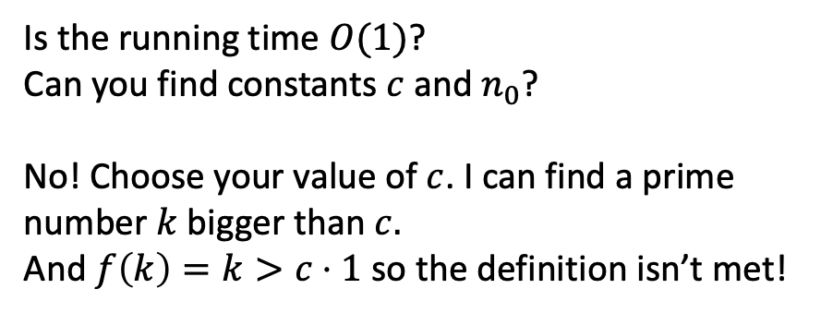
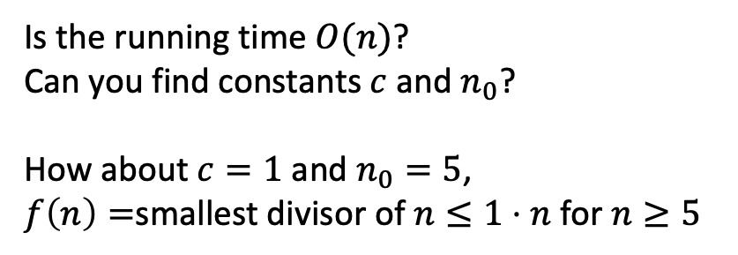
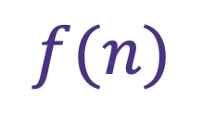
$f(n)$ is $O(g\left(n\right))$ if there exist positive constants $c, n_{0}$ such that for all $n≥n_{0}$,
$$f\left(n\right)≤c⋅g\left(n\right)$$
Big-O
$$f(n)$$
Is the running time $O(n)$?
Can you find constants $c$ and $n_{0}$?
How about $c=1$ and $n_{0}=5$,
$f\left(n\right)=$smallest divisor of $n≤1⋅n$ for $n≥5$
Is the running time $O(1)$?
Can you find constants $c$ and $n_{0}$?
No! Choose your value of $c$. I can find a prime number $k$bigger than $c.$
And $f\left(k\right)=k>c⋅1$ so the definition isn’t met!
It’s $O(n)$ but not $O\left(1\right)$

Slide 31
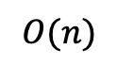
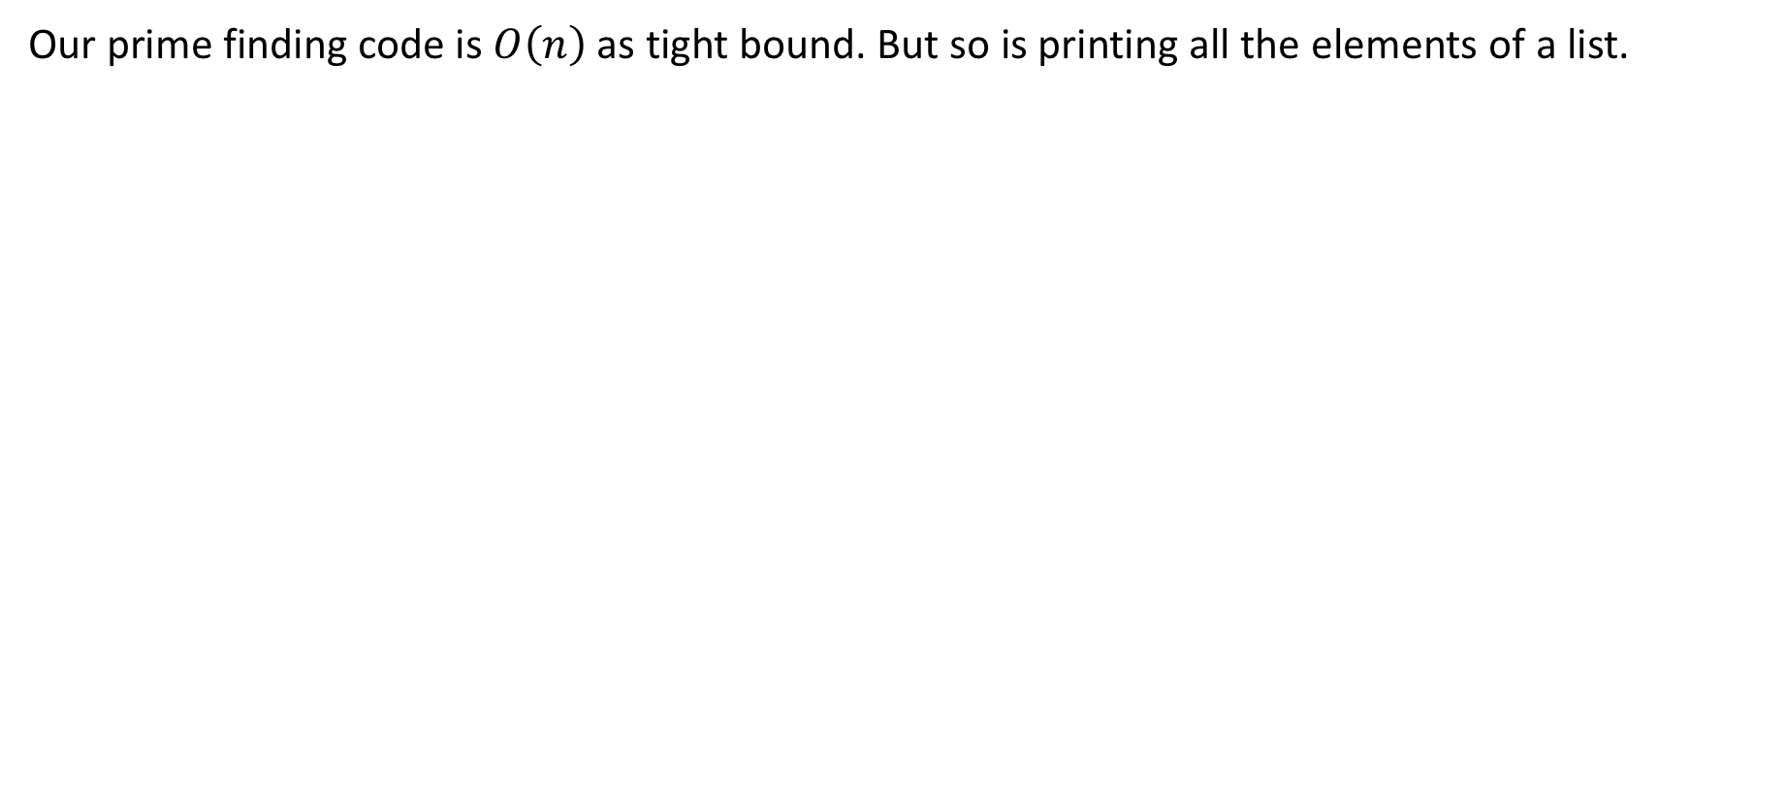
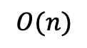
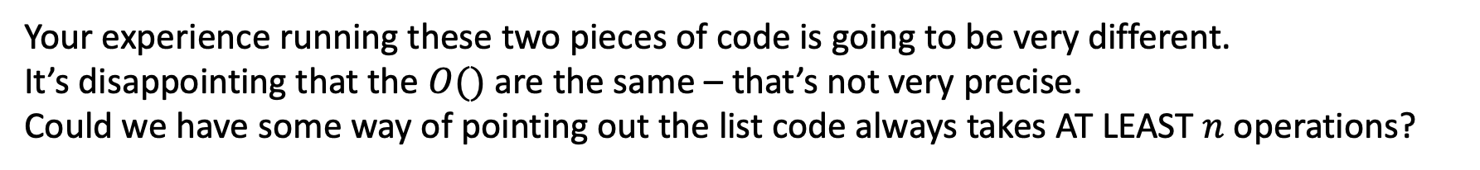
Big-Oh isn’t everything
Our prime finding code is $O\left(n\right)$as tight bound. But so is printing all the elements of a list.
$$O(n)$$
$$O(n)$$
Your experience running these two pieces of code is going to be very different.
It’s disappointing that the $O()$ are the same – that’s not very precise.
Could we have some way of pointing out the list code always takes AT LEAST $n$ operations?

Slide 32
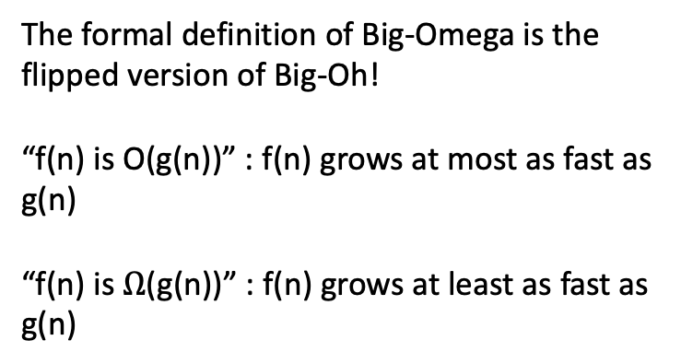

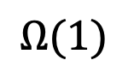

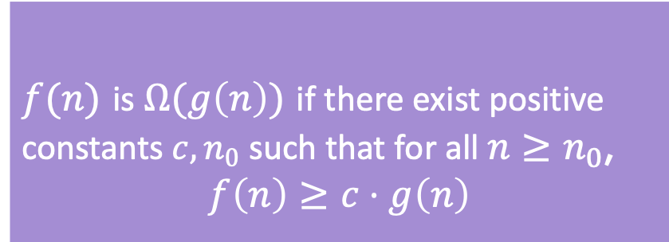
Big-$Ω$ [Omega]
$f(n)$ is $Ω(g\left(n\right))$ if there exist positive constants $c, n_{0}$ such that for all $n≥n_{0}$,
$$f\left(n\right)≥c⋅g\left(n\right)$$
Big-Omega
$f(n)$ is $O(g\left(n\right))$ if there exist positive constants $c, n_{0}$ such that for all $n≥n_{0}$,
$$f\left(n\right)≤c⋅g\left(n\right)$$
Big-O
The formal definition of Big-Omega is the flipped version of Big-Oh!
“f(n) is O(g(n))” : f(n) grows at most as fast as g(n)
“f(n) is $Ω$(g(n))” : f(n) grows at least as fast as g(n)
$$O(n)$$
$$Ω(1)$$

Slide 33
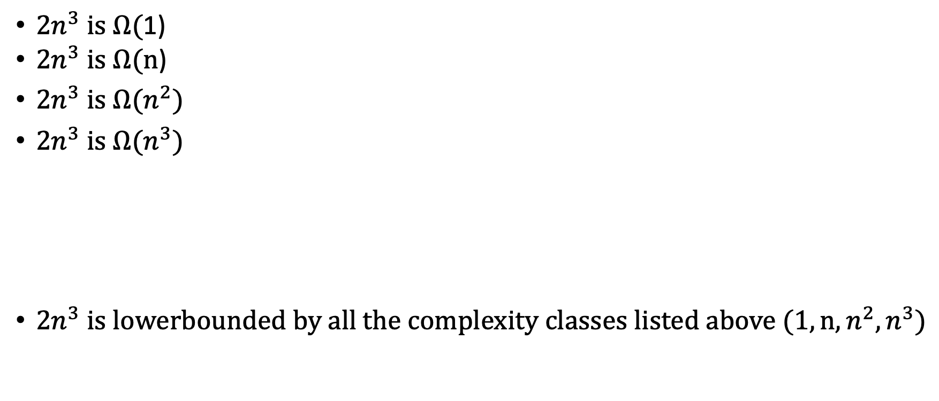
Big-Omega Also Doesn’t Have to be Tight
2n³
$2n^{3} is Ω($1)
${2n}^{3} is Ω(n$)
$2n^{3} is Ω(n^{2})$
${2n}^{3} is Ω(n^{3})$
$2n^{3} is lowerbounded by all the complexity classes listed above (1, n,n^{2},n^{3})$
$$T\left(n\right)$$
n³
n²
n
1
$$n$$

Slide 34
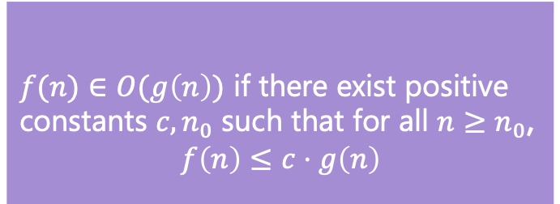
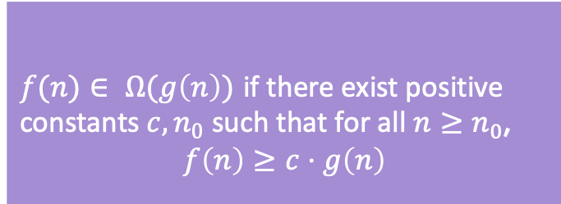
Examples
$f(n)$ $∈$ $O(g\left(n\right))$ if there exist positive constants $c, n_{0}$ such that for all $n≥n_{0}$,
$$f\left(n\right)≤c⋅g\left(n\right)$$
Big-O
4n² ∈ O(1)
false
4n² ∈ O(n)
false
4n² ∈ O(n²)
true
4n² ∈ O(n³)
true
4n² ∈ O(n⁴)
true
4n² ∈ Ω(1)
true
4n² ∈ Ω(n)
true
4n² ∈ Ω(n²)
true
4n² ∈ Ω(n³)
false
4n² ∈ Ω(n⁴)
false
$f(n)$ $∈ Ω(g\left(n\right))$ if there exist positive constants $c, n_{0}$ such that for all $n≥n_{0}$,
$$f\left(n\right)≥c⋅g\left(n\right)$$
Big-Omega

Slide 35
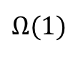

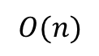
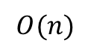
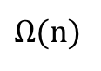
Tight Big-O and Big-$Ω$ Bounds Together
prime runtime function
f(n) = n
$$O(n)$$
$$O(n)$$
$Ω$(1)
$Ω$(n)
Note: most functions look like the one on the right, with the same tight Big-Oh and Big-Omega bound. But we’ll see important examples of the one on the left.

Slide 36
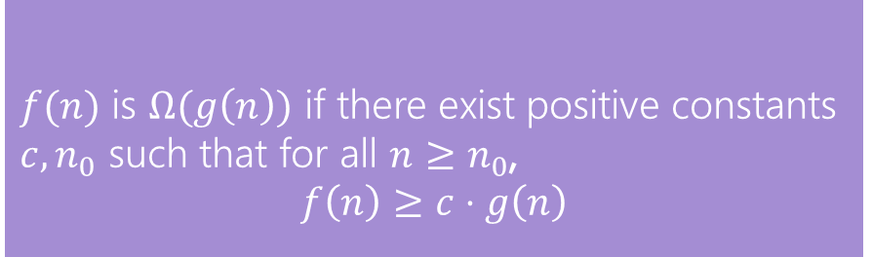
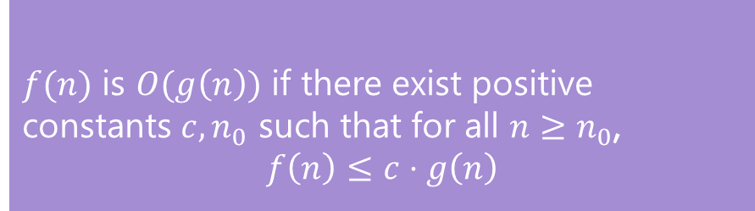
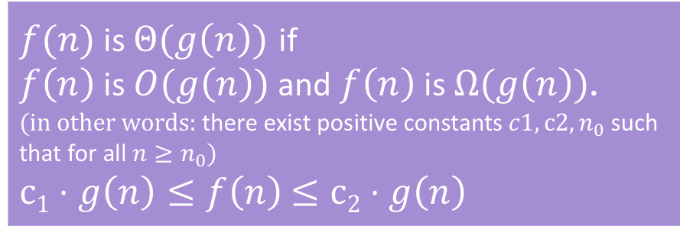
Oh, and Omega, and Theta, oh my
$f(n)$ is $O(g\left(n\right))$ if there exist positive constants $c, n_{0}$ such that for all $n≥n_{0}$,
$$f\left(n\right)≤c⋅g\left(n\right)$$
Big-Oh
Big-Oh is an upper bound
My code takes at most this long to run
Big-Omega is a lower bound
My code takes at least this long to run
Big Theta is “equal to”
My code takes “exactly”* this long to run
*Except for constant factors and lower order terms
Only exists when Big-Oh == Big-Omega!
$f(n)$ is $Ω(g\left(n\right))$ if there exist positive constants $c, n_{0}$ such that for all $n≥n_{0}$,
$$f\left(n\right)≥c⋅g\left(n\right)$$
Big-Omega
Big-Theta
$f(n)$ is $Θ(g\left(n\right))$ if
$f\left(n\right)$ is $O(g\left(n\right))$ and $f\left(n\right)$ is $Ω(g\left(n\right))$.
(in other words: there exist positive constants $c1, c2, n_{0}$ such that for all $n≥n_{0}$)
$c1⋅g\left(n\right)≤f\left(n\right)$ $≤c2⋅g\left(n\right)$

Slide 37

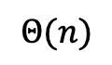
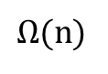
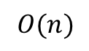
O, and Omega, and Theta [oh my?]
Big-Theta
Big Theta is “equal to”
My code takes “exactly”* this long to run
*Except for constant factors and lower order terms
$f(n)$ is $Θ(g\left(n\right))$ if
$f\left(n\right)$ is $O(g\left(n\right))$ and $f\left(n\right)$ is $Ω(g\left(n\right))$.
(in other words: there exist positive constants $c1, c2, n_{0}$ such that for all $n≥n_{0}$)
$c1⋅g\left(n\right)≤f\left(n\right)$ $≤c2⋅g\left(n\right)$
f(n) = n
To define a big-Theta, you expect the tight big-Oh and tight big-Omega bounds to be touching on the graph (the same complexity class)
$$O(n)$$
$Ω$(n)
$$Θ(n)$$

Slide 38
Recap: Where We’ve Just Gone
We just covered a lot of ground!
How to model code’s runtime with a function
How to characterize that function with a Big-Oh bound
Formal definition and proofs of Big-Oh
Other tools
On Wednesday, we’ll color in more details and dive deeper on step 1 (Code Modeling)
In the meantime, this PollEverywhere will stay open: let me know the questions you have about this topic! This will shape the review at the start of Wednesday.

